Slide 1




Financial Analysis
Using DAX Query

Slide 2





Case Background
You are a Financial Data Analyst tasked with analyzing credit card usage and financial metrics for a banking institution. Using the provided data, you will create reports in Power BI by applying DAX functions. Your goal is to calculate financial metrics like running totals, moving averages, and growth rates, and generate KPIs that assess customer behavior, credit utilization, and delinquency risk. The analysis will provide key insights for improving customer retention and financial performance.

Slide 3

Problem Statements
  Running Total of Credit Card Transactions
  Calculate the 4-week moving average of the creditLimit for each client.
  Calculate the mom% growth and wow% groth on transaction amount.
  Calculate Customer Acquisition Cost (CAC) as a Ratio of Transaction Amount.
  Calculate the yearly average of avg_utilization_ratio for all clients.
  Calculate the percentage of Interest_Earned compared to Total_Revolving_Bal for each client.
7. Calculate Top 5 Clients by Total Transaction Amount.

Slide 4
Problem Statements
8. Identify clients whose Avg_Utilization_Ratio exceeds 80%.
9. Customer Churn Indicator: Create a KPI that flags clients who have not made any transactions (Total_Trans_Amt = 0) in the last 6 months.
10.Delinquency Rate: Calculate the percentage of clients with Delinquent_Acc > 0.
11. Credit Risk Score: Create a score for each client based on their Avg_Utilization_Ratio, Delinquent_Acc, and Total_Revolving_Bal.
12. Income vs Credit Limit Correlation: Show the correlation between Income and Credit_Limit for all clients.
13. Average Customer Satisfaction Score by Credit Card Category: Calculate the average Cust_Satisfaction_Score by Card_Category.
14. Loan Approval vs Credit Limit: Analyze how Credit_Limit affects Personal_loan approval by calculating the average credit limit for clients with and without loans.
15. High Risk Clients Flag: Create a flag for clients whose Total_Revolving_Bal exceeds 90% of their Credit_Limit and who have a high Avg_Utilization_Ratio.

Slide 5
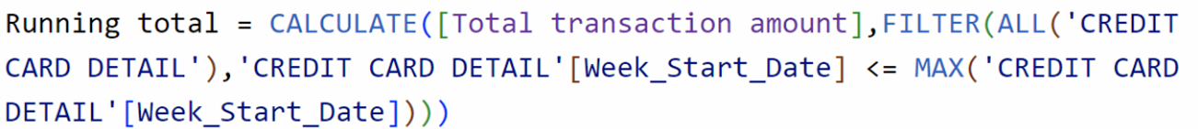
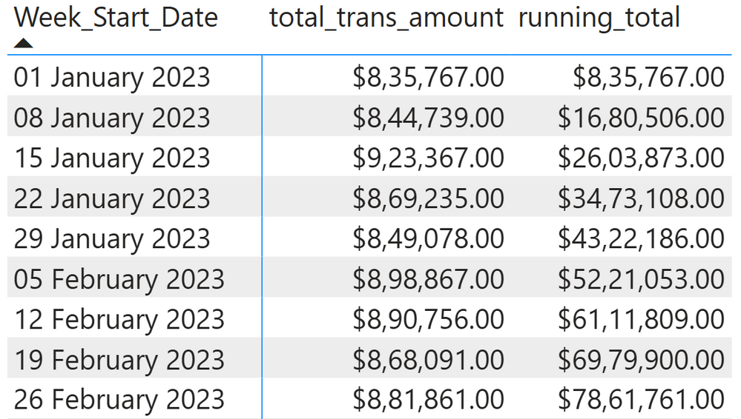
1.Running Total of Credit Card Transactions
DAX Query
Output

Slide 6
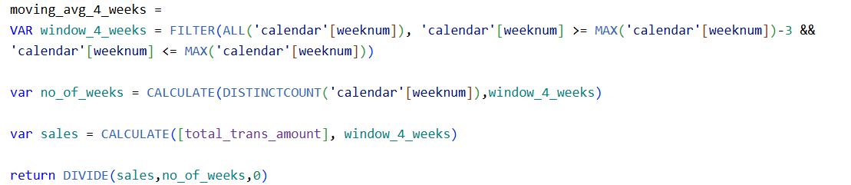
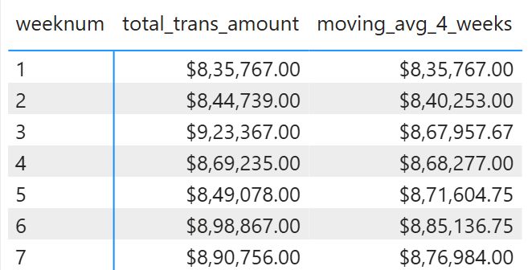
2. Calculate the 4-week moving average of the creditLimit for each client.
DAX Query
Output

Slide 7
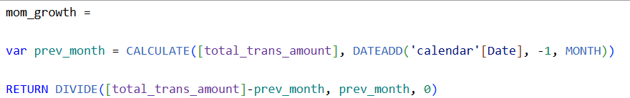
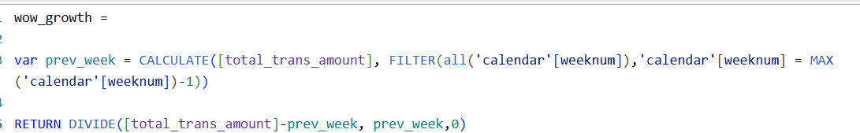
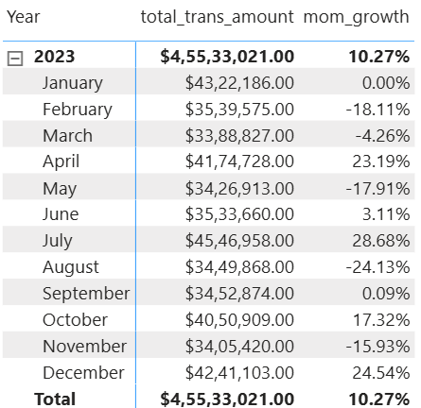
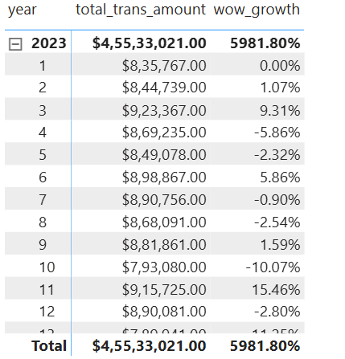
3. Calculate the mom% growth and wow% groth on transaction amount.
DAX Query
Output

Slide 8
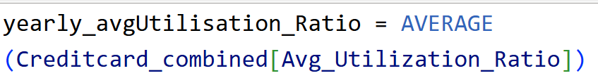
4. Calculate Customer Acquisition Cost (CAC) as a Ratio of Transaction Amount.
DAX Query
5. Calculate the yearly average of avg_utilization_ratio for all clients.
DAX Query

Slide 9
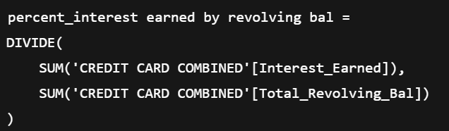
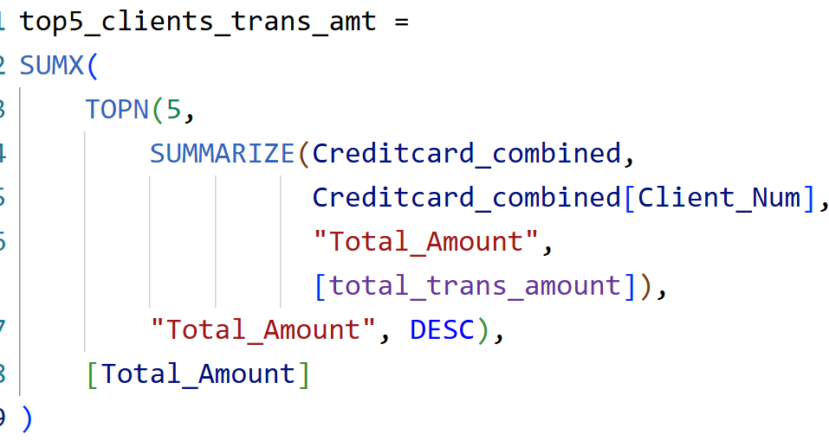
6. Calculate the percentage of Interest_Earned compared to Total_Revolving_Bal for each client.
DAX Query
7. Calculate the percentage of Interest_Earned compared to Total_Revolving_Bal for each client.
DAX Query

Slide 10
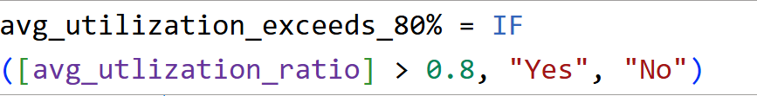
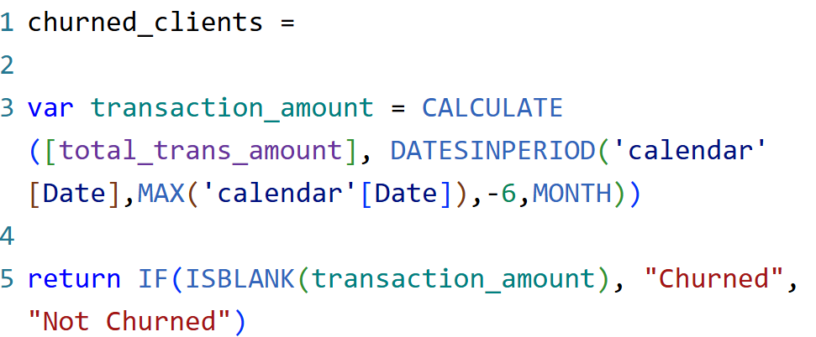
8. Identify clients whose Avg_Utilization_Ratio exceeds 80%
DAX Query
9.Customer Churn Indicator: Create a KPI that flags clients who have not made any transactions (Total_Trans_Amt = 0) in the last 6 months
DAX Query

Slide 11
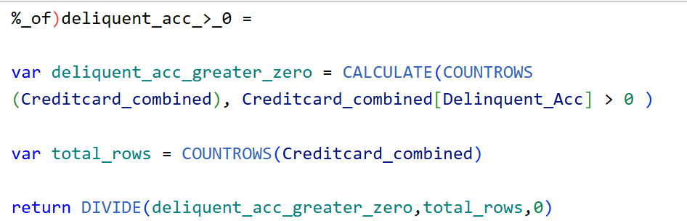
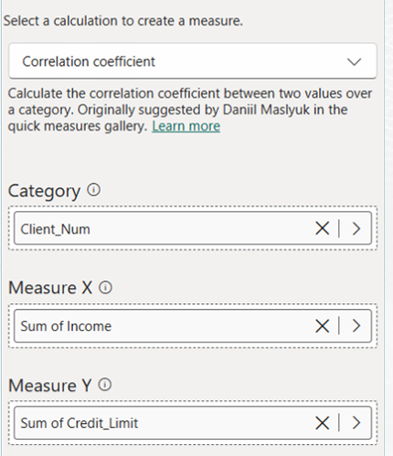
10. Delinquency Rate: Calculate the percentage of clients with Delinquent_Acc > 0.
DAX Query
11. Income vs Credit Limit Correlation: Show the correlation between Income and Credit_Limit for all clients.
Output

Slide 12
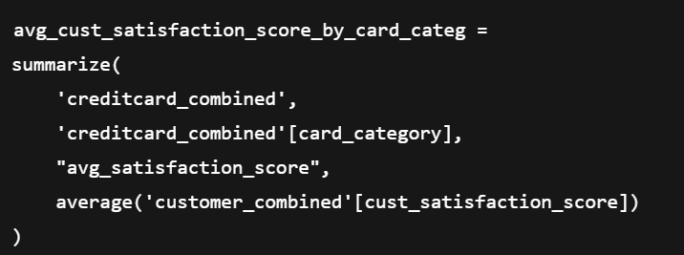
12. Average Customer Satisfaction Score by Credit Card Category: Calculate the average Cust_Satisfaction_Score by Card_Category.
DAX Query

Slide 13
13. Loan Approval vs Credit Limit: Analyze how Credit_Limit affects Personal_loan approval by calculating the average credit limit for clients with and without loans
DAX Query

Slide 14
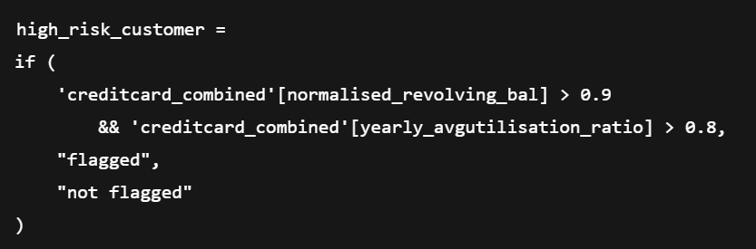
14. High Risk Clients Flag: Create a flag for clients whose Total_Revolving_Bal exceeds 90% of their Credit_Limit and who have a high Avg_Utilization_Ratio
DAX Query

Slide 15

Thank You
Presented By- Navneet Narayan

